Slide 1

Molecular Lego
Design for Molecular Actuators

Slide 2
Molecular Lego
CREATING NEW NANOSTRUCTURES: Proteins are made practically with a collection of building-block of molecules developed to Join together and form rigid structures whose overall shapes are completely preplanned by the designer, like a model made a tiny, oddly shaped Lego bricks.

Slide 3
Molecular Lego
Proteins are the fundamental nanomachines of life and serves the basis to create a nanomachinery.
Every protein generally starts as a simple, linear chain assembled from a specific sequence of amino acids drawn from a repertoire of just 20 amino acids.
The properties of a protein and what functions it can play out depend on its shape.

Slide 4
Molecular Lego
The chain of amino acids is put together in the cell where it forms an intricate tangle of helices and other structures through a complex process called protein folding.
The sequence of amino acids determines the final shape, but predicting what shape a particular sequence will take on is one of the most significant unsolved challenges of science and engineering (the “protein folding problem”).

Slide 5
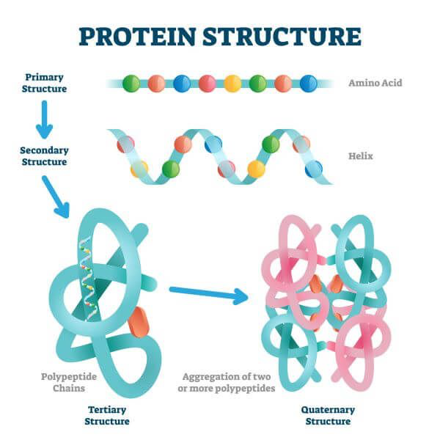

Slide 6
Applications of Molecular Lego
A way to produce large molecules with programmable shapes and the computer software required to design them was developed.
To create sensors: large molecules that change shape and color when they bind to particular target molecules such as glucose, toxins or chemical warfare agent.
The binding event triggers the sensor molecule to swing two fluorescent groups together that alter its color, thereby signaling that the target is present in the sample.

Slide 7
Molecular Lego
Technique to create long, hinged molecules that open and close in response to an external signal is a step toward the creation of molecular actuators, molecular valves and computer memories.

Slide 8
Molecular Lego
Example 4HB1, an artificial protein.
An artificial gene was first assembled and then inserted into a bacteria, which "expressed" it - that is, made the protein encoded by the gene's DNA.
After crystallization the structure was visualised to find it had the configuration for which it was designed.
yet it was determined that the protein folding steps may be more complex than it appears to be.
better way to create custom-designed nanomachinery would be to construct them from a limited set of modular building blocks that did not attain their shape via the folding process of proteins.

Slide 9
Molecular Lego
1995, Brent Iverson of the University of Texas at Austin had developed building blocks that could be chained together into short polymers called oligomers.
These oligomers then self-assembled into pleated structures as electron-rich donor groups pulled on electron-deficient acceptor groups in the structure.
Sam Gellman of the University of Wisconsin Madison and Dieter Seebach of the Swiss Federal Institute of Technology in Zurich developed synthetic molecules called beta-peptides, which are flexible chains of beta-amino acids.
These short beta-peptides fold into twisted helices.

Slide 10
Molecular Lego
Beta-amino acids are molecules that are mostly not naturally occurring and whose general structure is slightly different from that of regular amino acids (alpha-amino acids) .
Natural proteins and these new molecules involve chains of molecules connected by single bonds that leave the structure with a lot of freedom to bend at locations all along its length.

Slide 11
Molecular Lego
The way one of these molecules bends in acquiring its final shape depends on the complex interplay of attractive and repulsive forces arising when different building block all along the chain are brought closer together.
To eliminate the usual folding process altogether in order to gain more control over the shape of the final product.

Slide 13
Molecular Lego
Thus, rigid building blocks that could be attached to one another through pairs of bonds to create rigid, ladder like macromolecules were invented.
1987 J. Fraser Stoddart at the University of Sheffield in England, introduced the concept of a “molecular Lego Set” by creating molecular belts and collars from building blocks.
These novel molecular building blocks called Bis- amino acids.
These can be strung together to form protein like structures that have rigid, readily predictable and designable shapes.

Slide 14
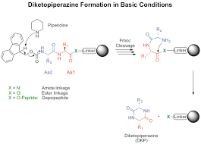
Molecular Lego
Potential applications of these Bis- Peptides include medicines, enzymes for catalysing useful, reactions, chemical sensors, nanoscale valves, computer storage devices.
Chemical structure called a diketopiperazine forms when six atoms join into a ring containing two amide bonds.

Slide 15
Molecular Lego
Each monomer would consist of a rigid molecule of mostly carbon atoms with two amino acid groups integrated into it.
And the amines and carboxyls of both amino acids would he available for bonding to other monomers.
Two monomers would join by having an amino acid group on each one reacting together to form a diketopiperazine ring.

Slide 16
Molecular Lego
The structure was called bis-amino acid ("bis" meaning "twice") because each one contains two amino acids.
And just as chains of amino acids are called peptides, they were named "bis-peptides."

